Slide 1
INTERFERENCE

Slide 2
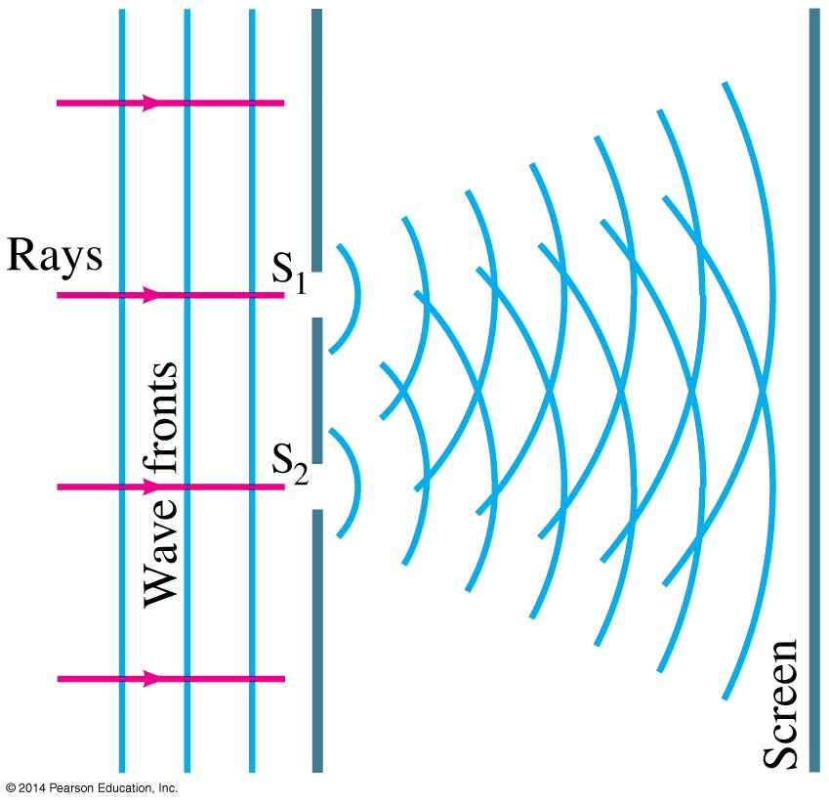
Interference—Young’s
Double-Slit Experiment
Phenomenon of maxima and minima when two waves super impose
The interference occurs because each point on the screen is not the same distance from both slits. Depending on the path length difference, the wave can interfere constructively (bright spot) or destructively (dark spot).

Slide 3
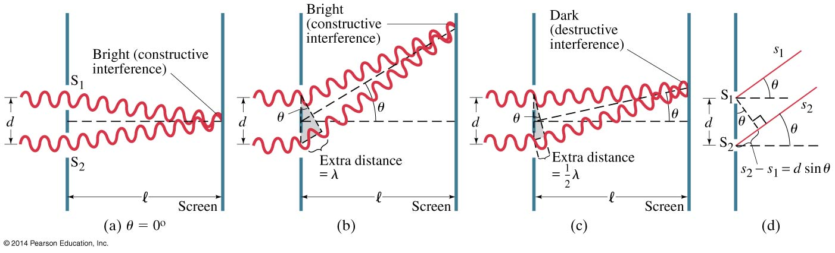
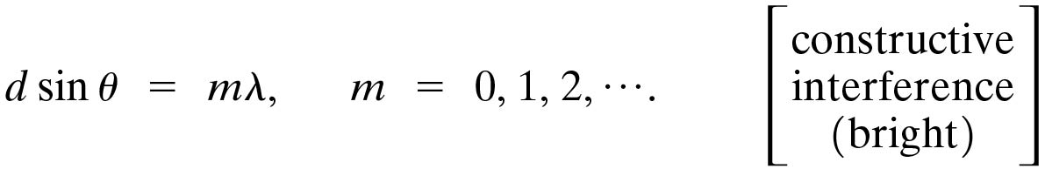
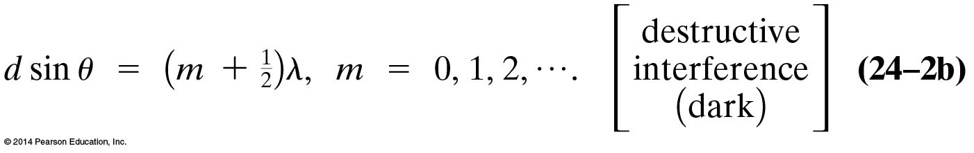
We can use geometry to find the conditions for constructive and destructive interference:

Slide 4
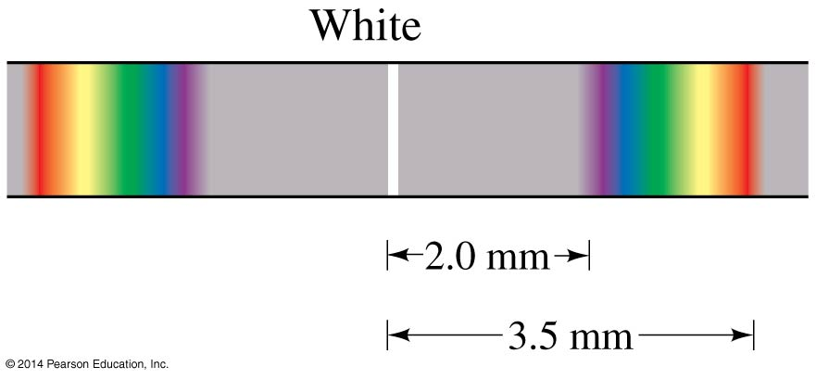
Interference with White Light
Since the position of the maxima (except the central one) depends on wavelength, the first- and higher-order fringes contain a spectrum of colors.

Slide 5
Interference in Thin Films
If there is a very thin film of material—a few wavelengths thick—light will reflect from both the bottom and the top of the layer, causing interference.
This can be seen in soap bubbles and oil slicks, for example.

Slide 6
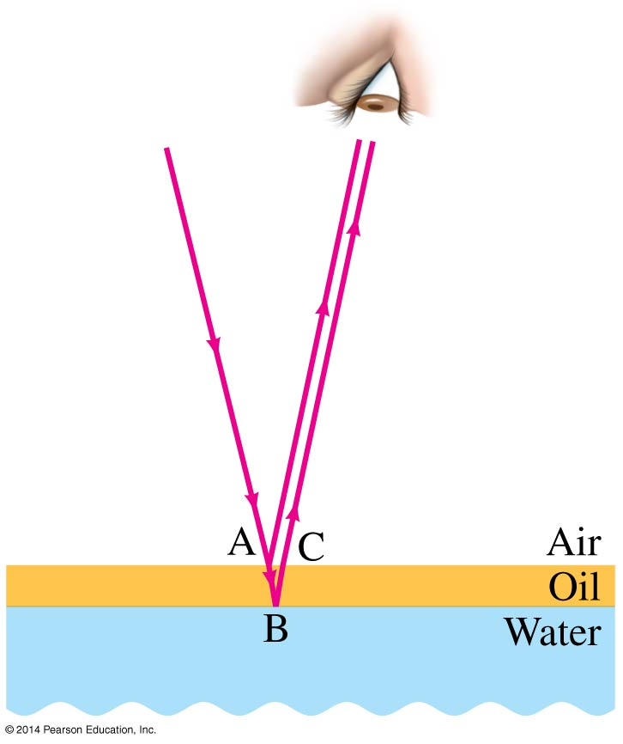
Interference in Thin Films
The wavelength of the light will be different in the oil and the air, and the reflections at points A and B may or may not involve reflection.

Slide 7
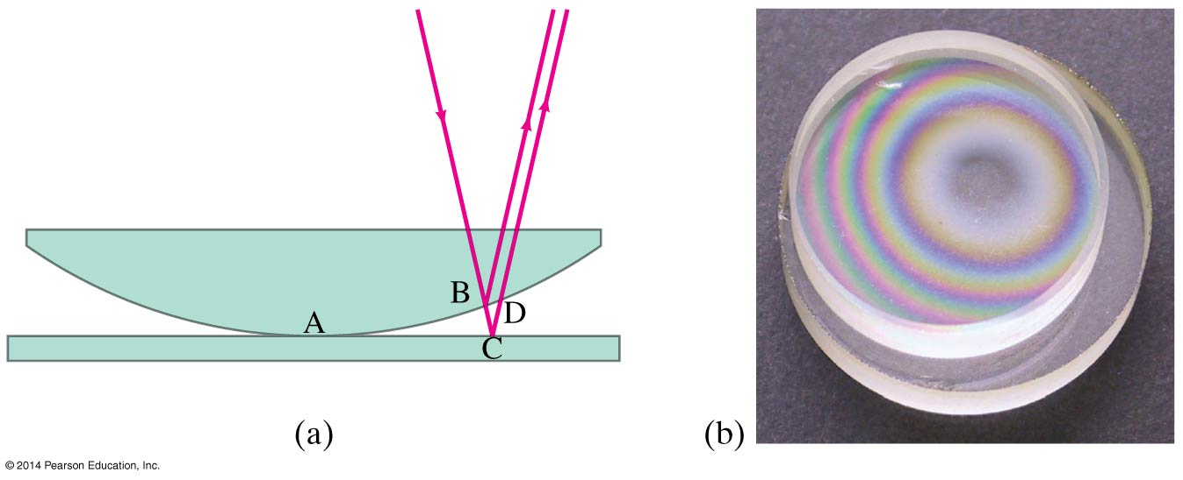
Interference in Thin Films
A similar effect takes place when a shallowly curved piece of glass is placed on a flat one. When viewed from above, concentric circles appear that are called Newton’s rings.

Slide 8
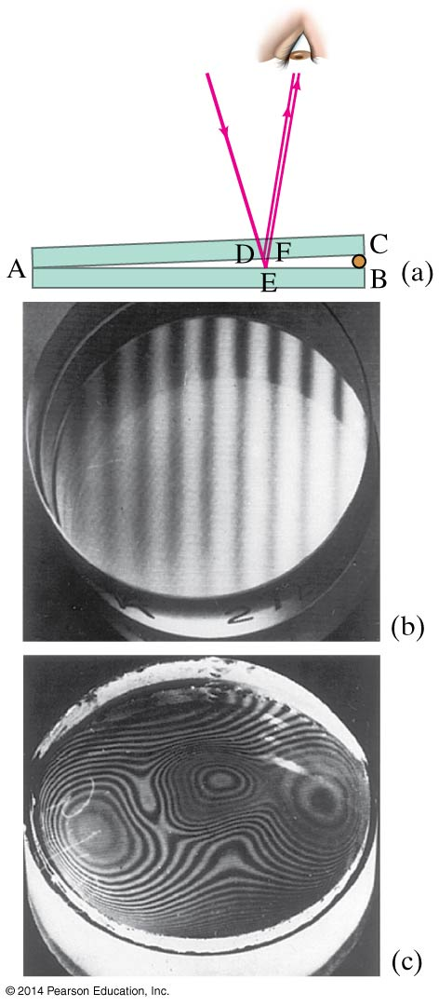
Interference in Thin Films
One can also create a thin film of air by creating a wedge-shaped gap between two pieces of glass.

